Slide 1

YouTube Titans: Unveiling YouTube's Top Creators, Trends and Insights
By Ashirwad Mishra

Slide 2
PART – 1 : GETTING FAMILIAR WITH THE DATASET

Slide 3
Dataset Overview:
This dataset focuses on prominent YouTube channels, offering a comprehensive look into their performance metrics and contextual data.
It's designed for deep analysis and insights into the top creators on the platform.
Content Scope:
The dataset includes essential metrics such as subscriber counts, total video views, upload frequency, country of origin, and earnings estimates for each YouTube channel.
Additional demographic and economic indicators for the channel's originating country provide context for analysis.

Slide 4
Key Columns:
Rank: Position of the YouTube channel based on subscriber count.
Youtuber: Name of the YouTube channel.
subscribers: Number of subscribers to the channel.
video views: Total views across all videos on the channel.
category: Category or niche of the channel.
Country: Country where the YouTube channel originates.
channel_type: Type of the YouTube channel.
uploads: Total number of videos uploaded on the channel.
lowest_monthly_earnings, highest_monthly_earnings: Estimated monthly earnings range from the channel.
lowest_yearly_earnings, highest_yearly_earnings: Estimated yearly earnings range from the channel.
subscribers_for_last_30_days: Number of new subscribers gained in the last 30 days.
created_year, created_month, created_date: Details about when the YouTube channel was created.
Gross tertiary education enrollment (%), Population, Unemployment rate, Urban_population: Socio-economic indicators of the country where the channel originates.
Latitude, Longitude: Geographic coordinates of the country.

Slide 5
Utility:
Enables analysis on factors influencing channel success such as demographics, economic conditions, and content strategy.
Offers a rich dataset for research, benchmarking, and comparative analysis within the YouTube ecosystem.
Exploration Potential:
Facilitates exploration of correlations between variables like subscriber growth and economic factors of the country.
Allows for trend analysis over time since creation and comparison across different channel categories and types.

Slide 6
PART – 2 : CLEANING THE DATASET

Slide 7
Problems with the data set:
Messy Data :
‘created_year’,’created_month’ and ‘created_date’ can be combined together to form a datetime column for ease of analysis
Dirty Data :
Rows are duplicated – specifically 11
Rows like Youtube Movies, Youtube Music have no uploads and are not actually channels.
‘subscribers’ has 3 null values – rank 978,979,980
‘category’ has null values – 53
‘Title’ column seems to be a redundant column, also has a lot of inconsistencies. Could be dropped if needed.
‘Country of origin’ has many null values. Also, ‘country’ is a redundant column with inconsistent data.
‘abbreviation’ has null values
‘channel type’ has null values
‘rank’ has some exceptionally large values for channels with 0 views, eg. YT Music,etc
‘rank’ has one null value – channel named ‘LEGENDA FUNK’ which is not given a rank
‘country_rank’ has null values.
‘country_rank’ seems to have very inaccurate values as well, needs to be redone
‘channel_type_rank’ has the same issues as ‘country rank’

Slide 8
Dirty Data :
‘video_views_for_the_last_30_days’ has null values. Can’t say about accuracy much.
‘subscribers_for_30_days’ has null values.
‘created_year’,’created_date’ has 5 null values
‘created_month’ has 12 null values
‘created_year’ has an outlier with year = 1970. Will be removed as it is not a YouTube channel.
‘Gross tertiary education enrollment (%)’,‘Population’
‘Unemployment rate’,‘Urban_population’, ‘Latitude’, ‘Longitude’ has null values. A fact about all these rows is that, they are missing for the rows which has ‘country’ value missing. 115 such rows. They can absolutely not be filled without knowledge about each of the channels through web search. Thus, these rows will not be included in the analysis, and conclusions would be made using the other rows.
An observation - Kuwait and Singapore has population equal to urban population.
‘youtuber’- Busy Fun Ltd is removed because most of its columns values are null. Cannot be filled at all

Slide 9
PART – 3 : ANALYSING AND REPORTING INSIGHTS FROM THE DATASET

Slide 10
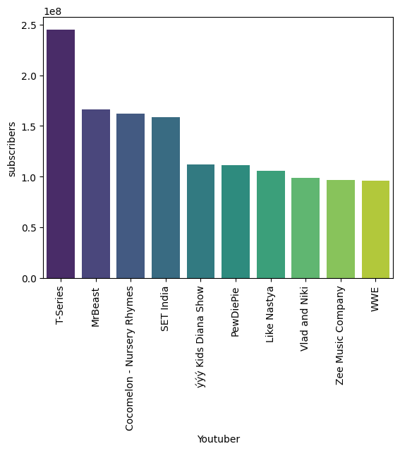
1. What are the top 10 YouTube channels based on the number of subscribers?
The bar graph displays the subscriber counts of the top 10 YouTube channels.
T-Series leads significantly with over 250 million subscribers, followed by channels like MrBeast, Cocomelon - Nursery Rhymes, and SET India, each with over 100 million subscribers.
Channels like PewDiePie, Like Nastya, and WWE also feature prominently, each with substantial subscriber bases but notably fewer than T-Series.

Slide 11
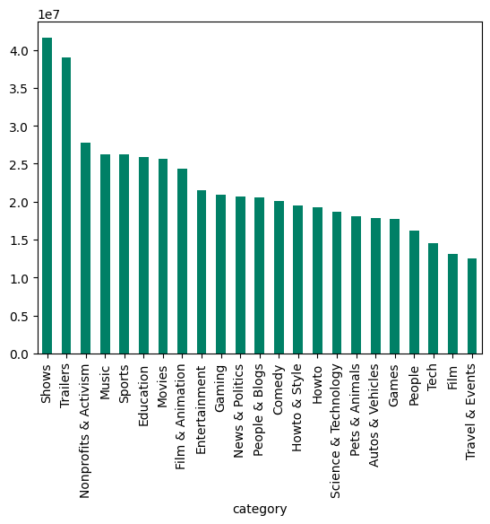
2. Which category has the highest average number of subscribers?
The bar graph indicates that the "Shows" category has the highest average number of subscribers, exceeding 40 million. "Trailers" and "Nonprofits & Activism" follow, each averaging over 30 million subscribers.
"Shows" and "Trailers": These categories often feature professionally produced content, including popular TV shows, movie trailers, and web series, which tend to attract large, dedicated audiences.

Slide 12
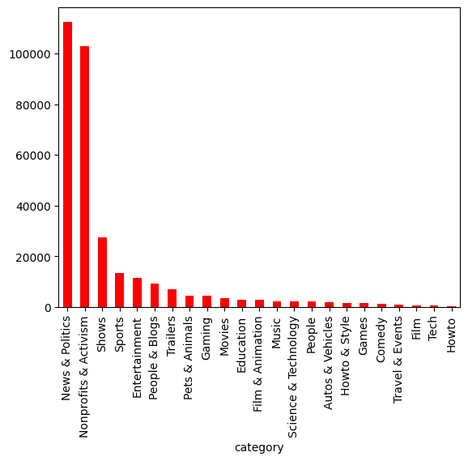
3. How many videos, on average, are uploaded by YouTube channels in each category?

Slide 13
3. How many videos, on average, are uploaded by YouTube channels in each category?
High Volume Categories: News & Politics and Nonprofits & Activism have the highest average number of uploads, exceeding 100,000 and 80,000 respectively. These categories often require frequent updates and continuous content creation to keep their audiences informed and engaged.
Moderate Volume Categories: Categories like Shows, Sports, Entertainment, and People & Blogs show a moderate number of uploads, ranging from 10,000 to 20,000. These categories balance consistent content creation with maintaining quality and relevance.
Low Volume Categories: Categories such as How-to, Tech, Film, and Travel & Events have significantly fewer uploads, generally below 1,000. These categories might focus on high-quality, less frequent content that is more evergreen and less time-sensitive.
CONCLUSION :
Categories that thrive on current events and ongoing updates (like News & Politics, Nonprofits & Activism) naturally have higher upload frequencies to stay relevant. Conversely, categories focused on more static or timeless content (like Tech, Film, Travel & Events) have lower upload frequencies as their content remains relevant for longer periods.

Slide 14
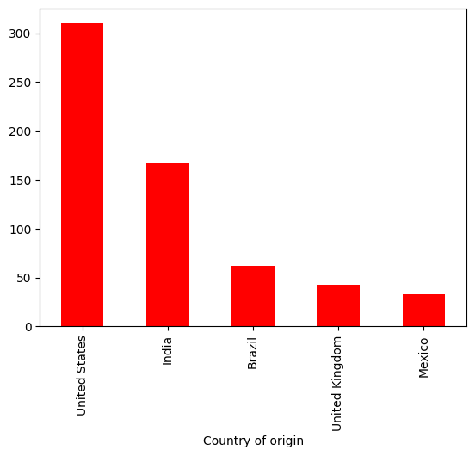
4. What are the top 5 countries with the highest number of YouTube channels?
US Dominance: The United States leads with the highest number of YouTube channels, nearing 300, indicating a strong content creation culture.
India’s Strong Presence: India follows with over 150 channels, showcasing significant digital content growth.

Slide 15
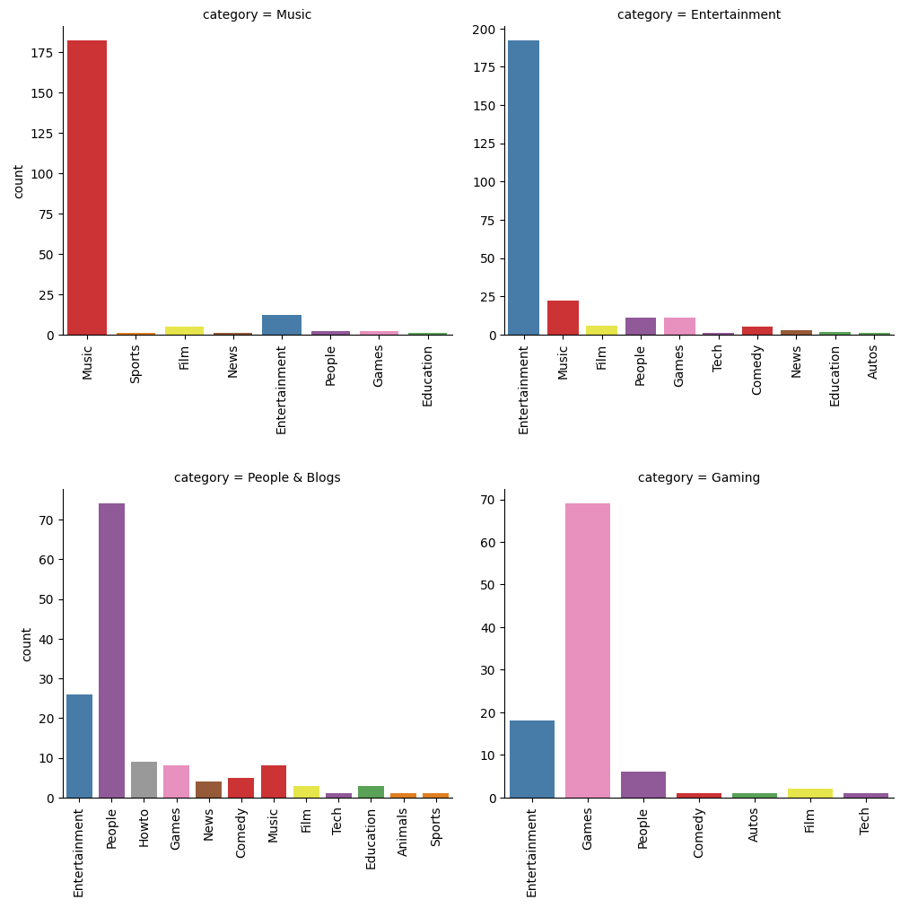
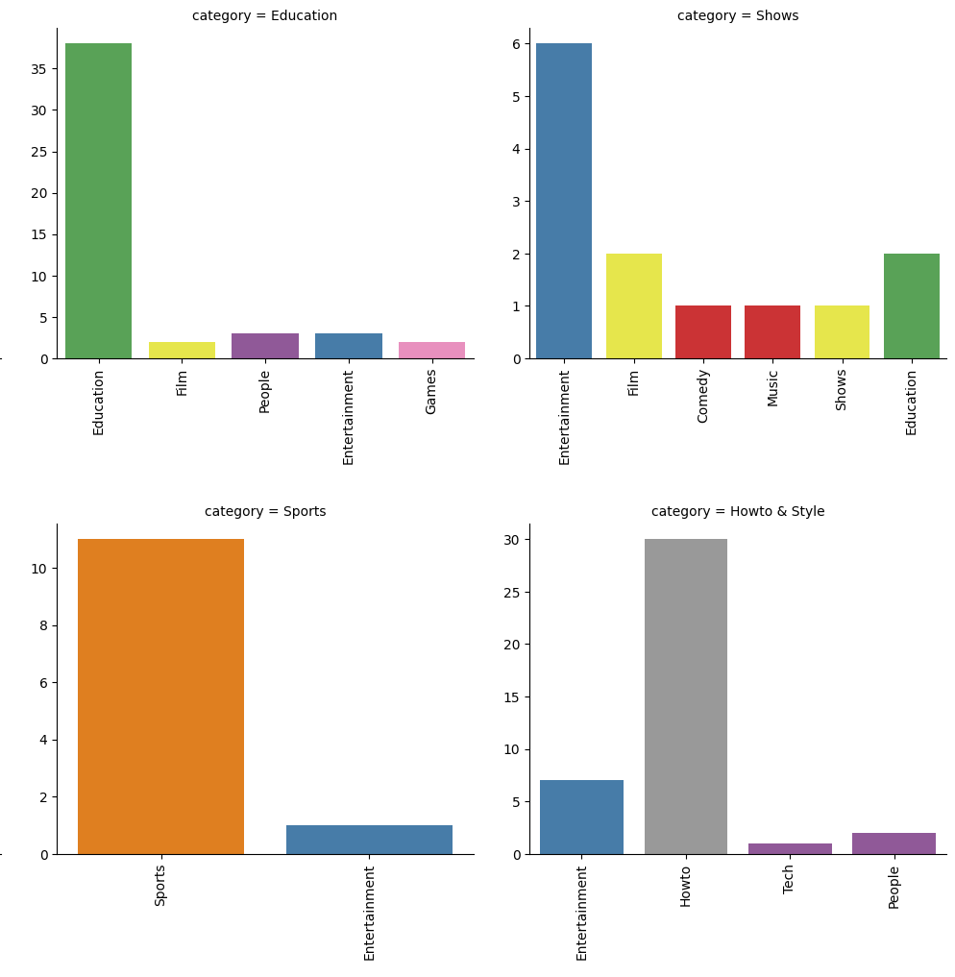
5. What is the distribution of channel types across different categories?

Slide 16
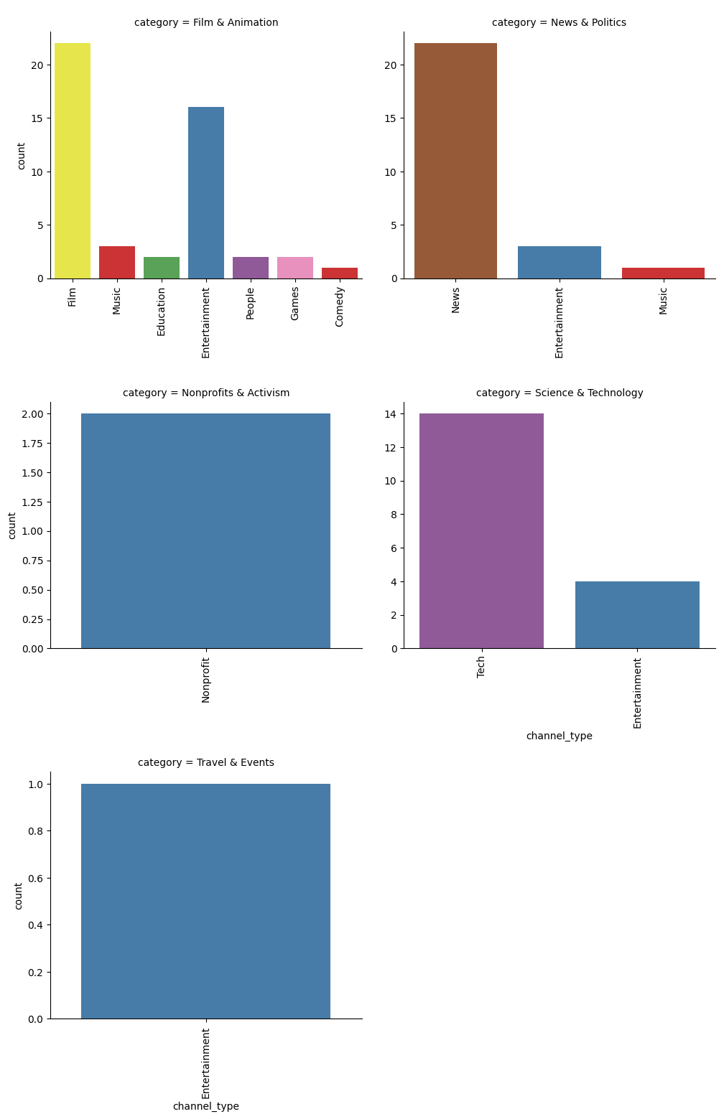
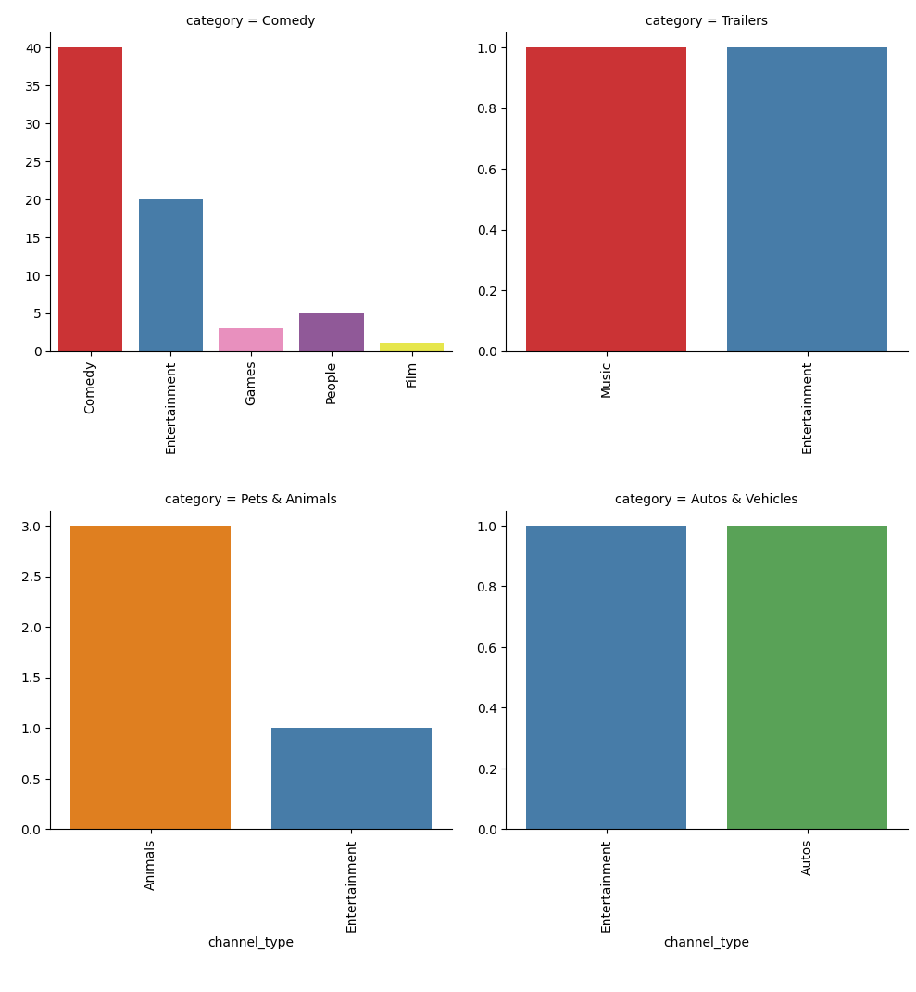
5. What is the distribution of channel types across different categories?

Slide 17
5. What is the distribution of channel types across different categories?
Category Specialization: Channels often have higher counts in their own categories, indicating specialization.
Entertainment Diversity: The Entertainment category has a more even distribution, suggesting a variety of content types within this category.
Opportunities for Growth: Less saturated channel types within these categories may offer growth opportunities for new content creators.
Education Focus: The ‘Education’ category has a notable focus with a count of 35, suggesting a concentration of educational content.
Shows Variety: The ‘Shows’ category displays diversity with several subcategories like ‘Entertainment’, ‘Film’, and ‘Comedy’.
Sports Niche: ‘Sports’ appears as a niche category with a lower count, indicating fewer channels or content in this area.
Howto & Style Diversity: ‘Howto & Style’ shows a range of content, with one unnamed category reaching a count of 25, highlighting a potential area of interest.

Slide 18
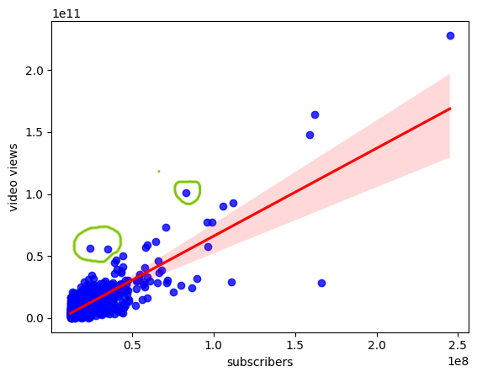
6. Is there a correlation between the number of subscribers and total video views for YouTube channels?
Positive Correlation: There’s a clear positive correlation, suggesting that channels with more subscribers tend to have more video views.
Most Channels are Small: The concentration of data points near the origin implies that most channels have lower subscribers and views.
Variability at Higher Levels: The spread of data points increases with higher subscriber counts, indicating variability in views among larger channels.
Outliers Exist: Some channels have high views or subscribers, deviating from the average trend.
In conclusion, while subscriber count is a good indicator of video views, it’s not absolute, and there’s considerable variability, especially among channels with larger audiences.

Slide 19
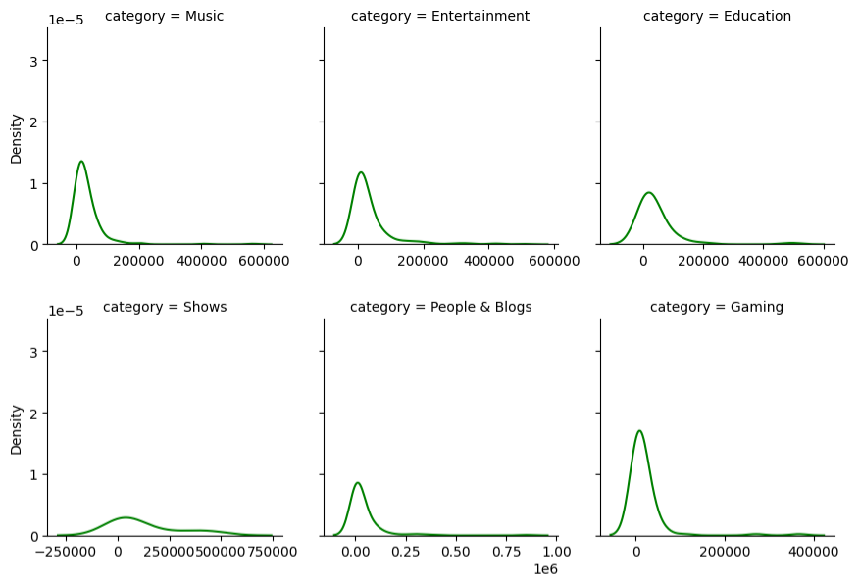
7. How do the monthly earnings vary throughout different categories?
Lowest monthly earnings

Slide 20
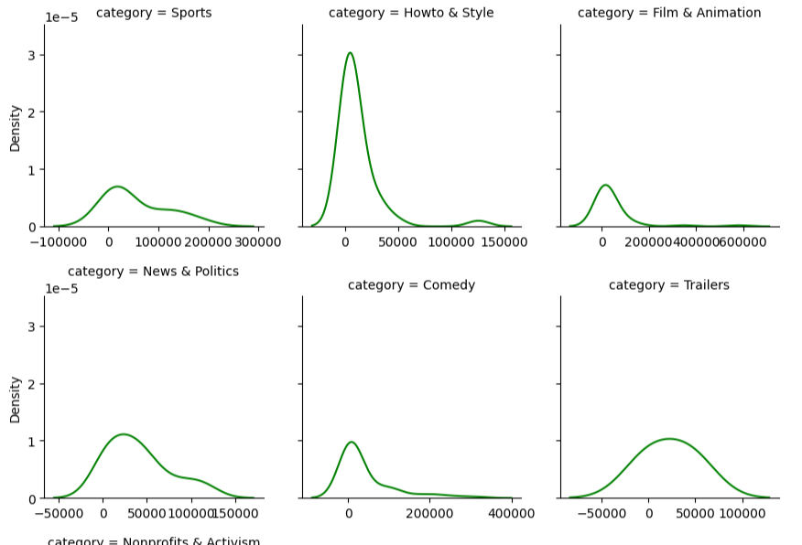
7. How do the monthly earnings vary throughout different categories?
Lowest monthly earnings

Slide 21
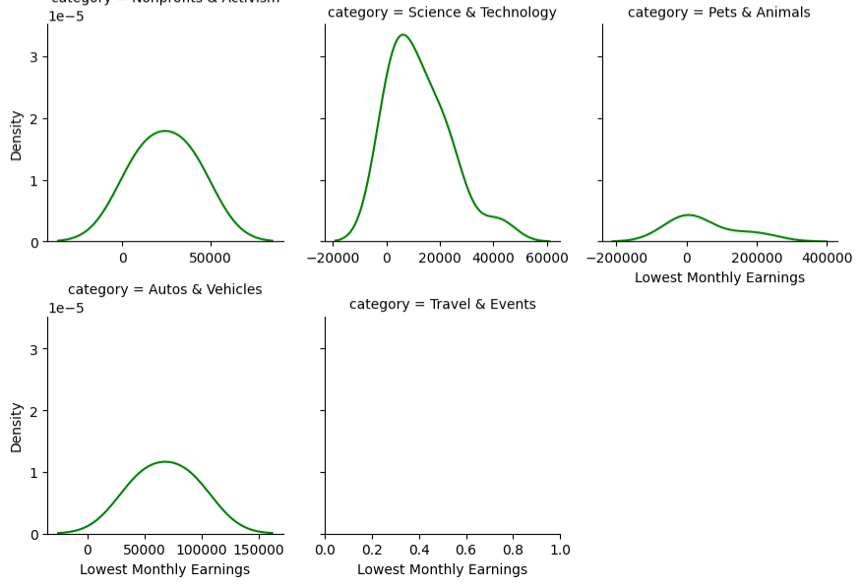
7. How do the monthly earnings vary throughout different categories?
Lowest monthly earnings

Slide 22
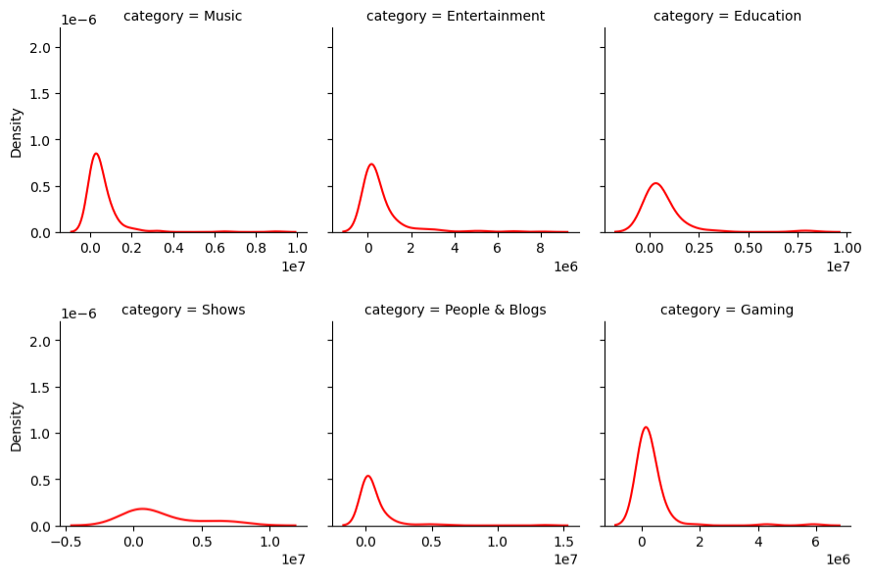
7. How do the monthly earnings vary throughout different categories?
Highest monthly earnings

Slide 23
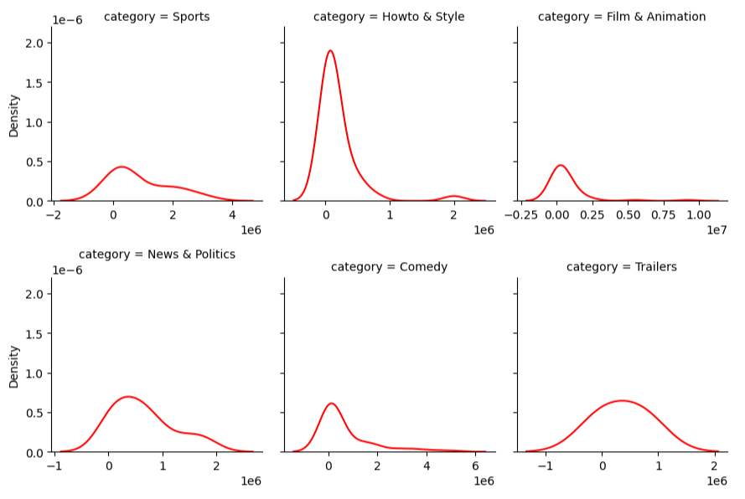
7. How do the monthly earnings vary throughout different categories?
Highest monthly earnings

Slide 24
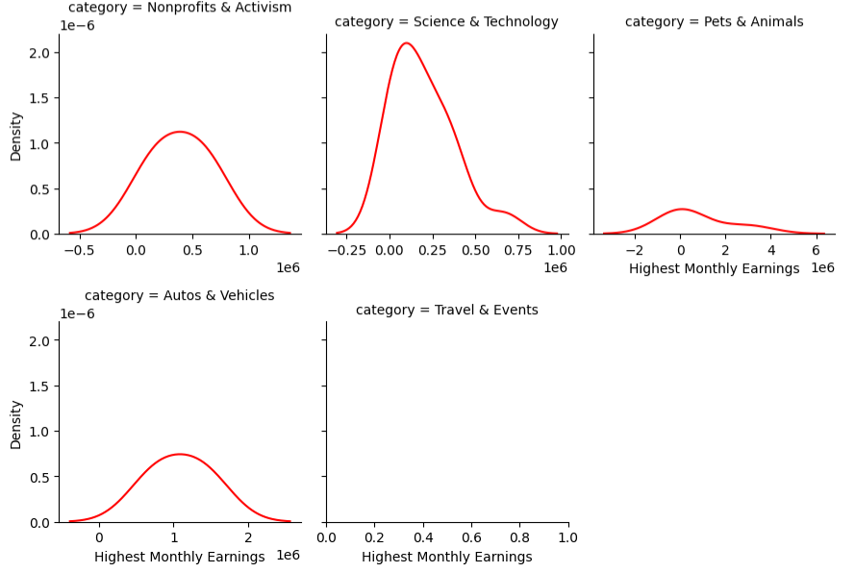
7. How do the monthly earnings vary throughout different categories?
Highest monthly earnings

Slide 25
7. How do the monthly earnings vary throughout different categories?
While there is potential for high earnings in all categories, Gaming channels tend to have higher least monthly earnings, whereas Education and People & Blogs channels generally earn less. Entertainment-related categories like Music and Shows offer a broad range of earning potentials.
Categories like ‘Howto & Style’ and ‘Comedy’ show a broad range of earnings, while ‘Sports’, ‘News & Politics’, and ‘Trailers’ tend to have more channels earning lower amounts. ‘Film & Animation’ stands out with a more even distribution, suggesting a balanced earning potential across channels.
Music and Entertainment categories have the potential for high earnings but also show significant variability.
Education and Gaming categories tend to have more consistent earnings among their channels.
Shows category might be challenging in terms of earning potential compared to others.
People & Blogs category shows a diverse range of earnings, reflecting the varied nature of content within this category.
News & Politics: The peak at the lower end suggests many channels earn less, with a tail extending towards higher earnings.
Comedy: The earnings distribution is broad, indicating potential for both low and high earnings among channels.

Slide 26
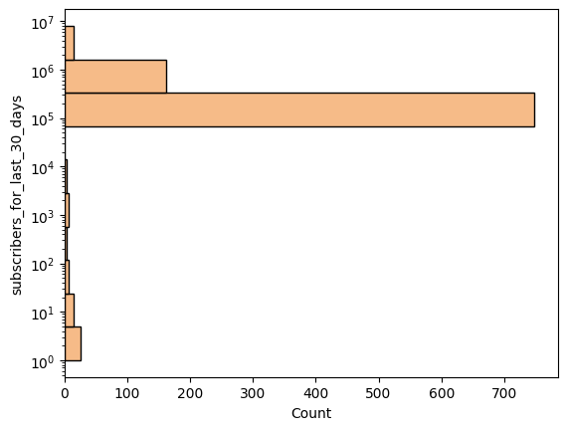
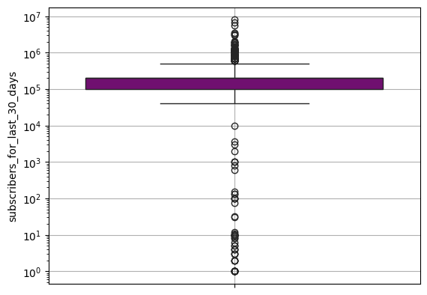
8. What is the overall trend in subscribers gained in the last 30 days across all channels?

Slide 27
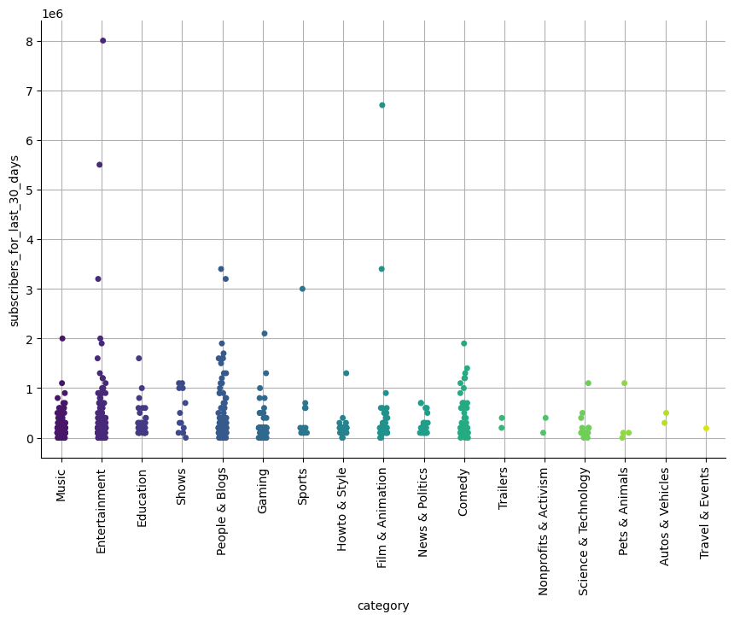
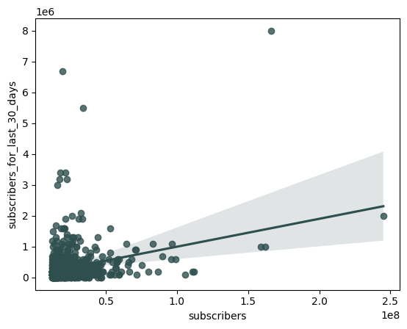
8. What is the overall trend in subscribers gained in the last 30 days across all channels?

Slide 28
8. What is the overall trend in subscribers gained in the last 30 days across all channels?
This distribution indicates that while most channels have a low number of new subscribers, there are few channels with an exceptionally high number of new subscribers, suggesting a highly skewed distribution with outliers that have unusually high subscriber growth.
There is a significant number of outliers, suggesting that there are values that are much higher than the typical range of the dataset.
The distribution of the data points, particularly the position of the median and the IQR, suggests that while there is a concentration of data within a certain range, the presence of outliers indicates variability in the dataset, with some values being significantly higher than the rest.
Channels with a higher number of total subscribers are likely to gain more new subscribers in a given month, as depicted by the regression plot.
The presence of outliers suggests that some channels gain an exceptionally high number of new subscribers, regardless of their total subscriber count.
The variability in new subscribers, as indicated by the spread of data points, suggests that factors other than the total subscriber count may influence the number of new subscribers gained.

Slide 29
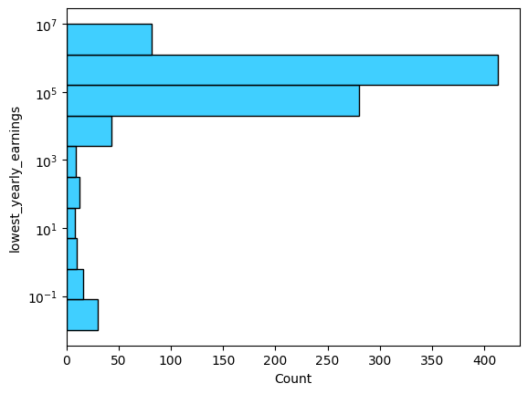
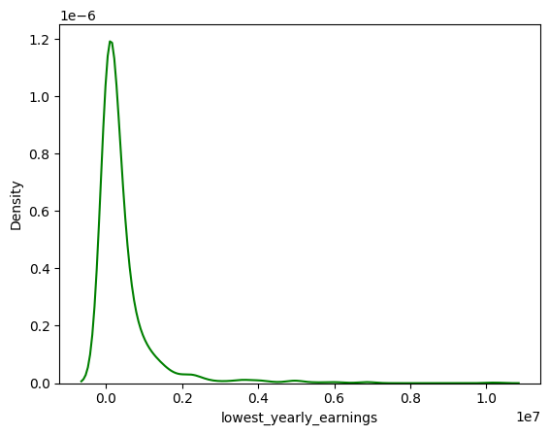
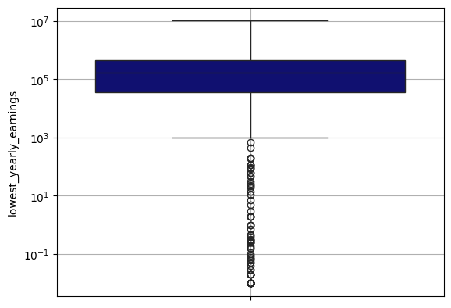
9. Are there any outliers in terms of yearly earnings from YouTube channels?
Lowest yearly earnings

Slide 30
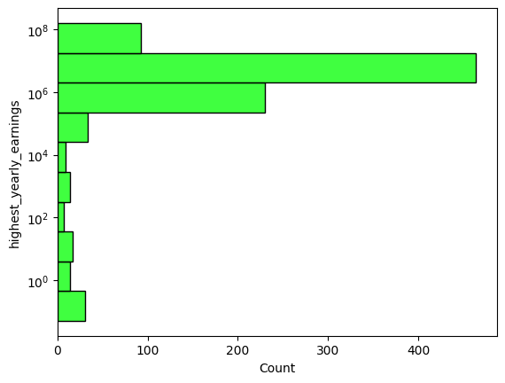
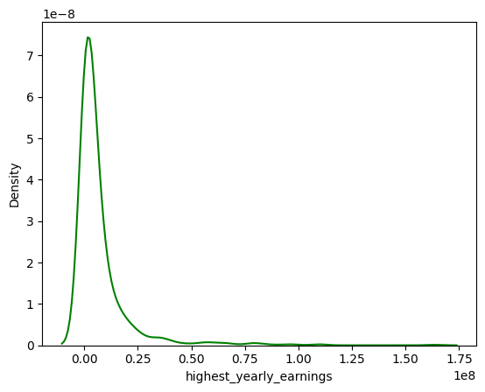
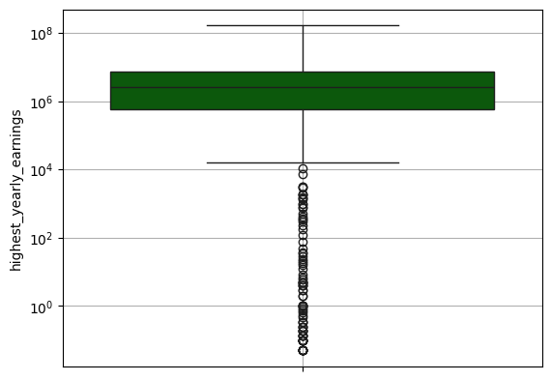
9. Are there any outliers in terms of yearly earnings from YouTube channels?
Highest yearly earnings

Slide 31
9. Are there any outliers in terms of yearly earnings from YouTube channels?
Earnings Range: The middle 50% of channels earn between 10^3 and 10^5.
Significant Outliers: There are channels with earnings as low as 10^−1, which are well below the typical range. The presence of outliers indicates a wide disparity in earnings among channels. There are outliers indicated by points above the upper whisker, extending up to 10^8, which suggests that some channels earn significantly more than the typical range.
Potential Factors: These outliers could be due to factors such as content type, audience size, monetization strategies, or channel activity levels. These outliers represent channels with the highest yearly earnings, far exceeding the average, likely due to factors such as high viewership, strong monetization strategies, or viral content.
In conclusion, while most channels have earnings within a common range, there’s a notable number of channels earning significantly less, highlighting the competitive and varied nature of content creation on platforms like YouTube. Also, there’s a small number of channels with exceptionally high earnings, highlighting the potential for substantial financial success on platforms like YouTube.

Slide 32
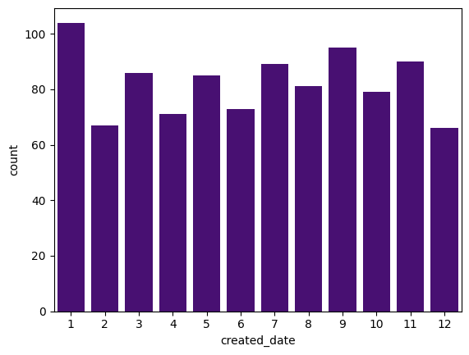
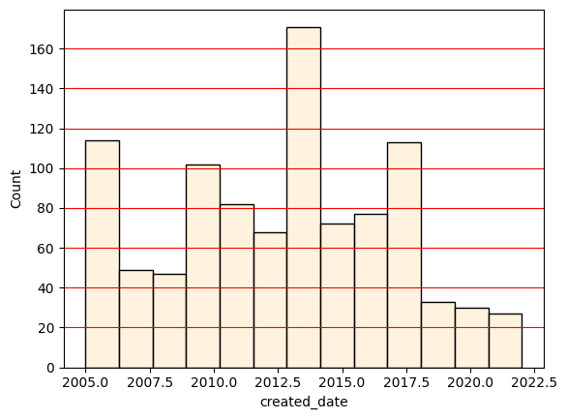
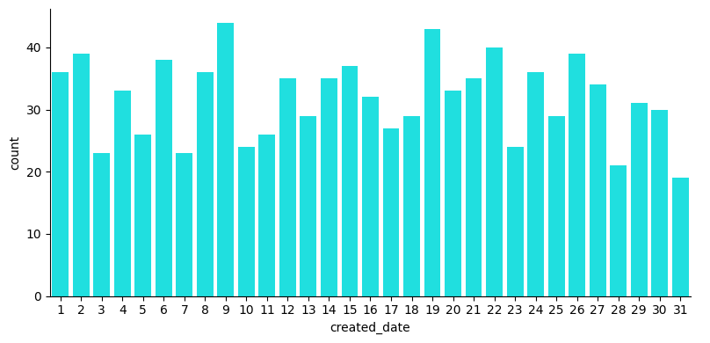
10. What is the distribution of channel creation dates? Is there any trend over time?

Slide 33
10. What is the distribution of channel creation dates? Is there any trend over time?
There are no significant trends in the channel creation day and month as these are quite evenly distributed amongst the channels in this dataset. This is quite typical and in line with the hypothesis that creation day/month is random and is spread out evenly.
However, there is a trend in the creation year column.
Initial Growth: Starting from 2005, there is a gradual increase in the number of channels created, reflecting the growing popularity and awareness of YouTube as a platform for content creation.
Peak Creation: Around 2012.5, there is a significant peak with over 140 channels created, possibly influenced by YouTube’s expanding global reach and the introduction of new features that attracted creators.
The peak in 2012.5 could be related to YouTube’s increasing cultural impact and the rise of video as a dominant form of online content.
Overall, the trend shows that while interest in creating YouTube channels has fluctuated over time, the platform continues to attract new creators each year.

Slide 34
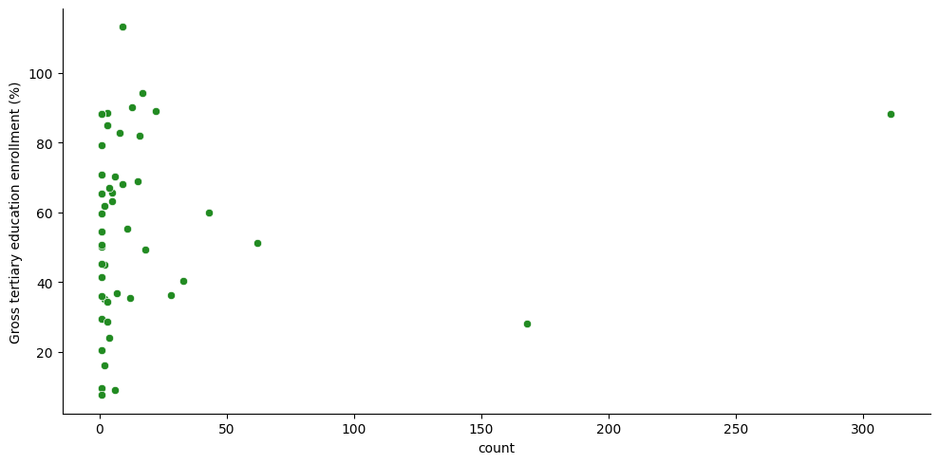
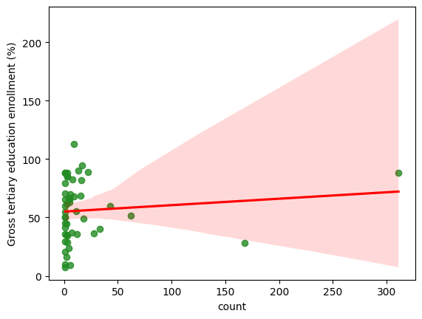
11. Is there a relationship between gross tertiary education enrollment and the number of YouTube channels in a country?

Slide 35
11. Is there a relationship between gross tertiary education enrollment and the number of YouTube channels in a country?
On the basis of the reg plot, we can say that although clear trends are not visible, we can still give some concrete conclusions about this data.
Education and Digital Engagement: The general trend suggests that countries with higher education enrollment percentages tend to have more YouTube channels, possibly reflecting a more digitally engaged population.
Outliers: Some countries with a high number of YouTube channels do not have correspondingly high tertiary education enrollment, which could be due to cultural, economic, or policy factors that encourage content creation.
Confidence Interval: The widening confidence interval at higher channel counts suggests greater variability and less predictability in the relationship at these levels.
The outliers highlight that while education may be a factor, it is not the sole determinant of YouTube channel creation, and other influences must be considered.

Slide 36
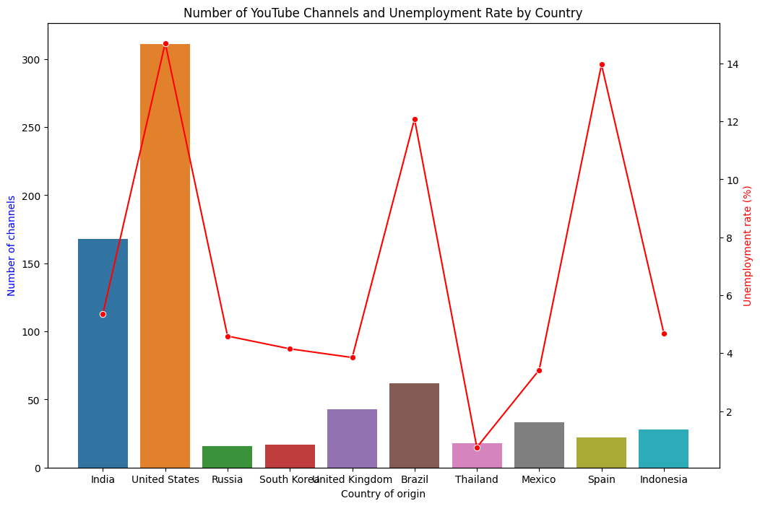
12. How does the unemployment rate vary among the top 10 countries with the highest number of YouTube channels?

Slide 37
12. How does the unemployment rate vary among the top 10 countries with the highest number of YouTube channels?
No Direct Correlation: The graph shows no direct correlation between the number of YouTube channels and the unemployment rate within these countries.
The US has a higher unemployment rate as compared to Brazil, also has more number of channels. But then Spain also has a highest unemployment rate than Brazil and still has lesser number of YT channels, showing no clear trend.
Digital Engagement: The number of YouTube channels in a country does not necessarily reflect its economic status as measured by unemployment rates.
Cultural Influence: Cultural factors and the popularity of digital platforms may play a significant role in the number of channels, independent of economic conditions.
Economic Factors: While economic challenges like high unemployment can impact digital content creation, they are not the sole determining factor, as seen in the case of India and Spain.

Slide 38
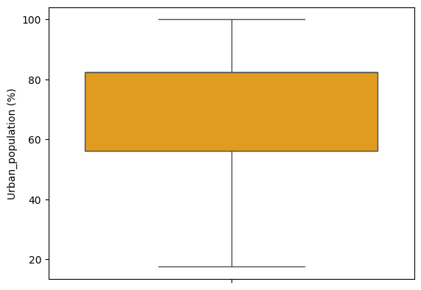
13. What is the average urban population percentage in countries with YouTube channels?
We can use this box plot to understand the distribution of Urban Population in the various countries included in our Youtube Dataset.
The average Urban Population (%) calculated using the Pandas-mean() function comes out to be 70.53, and is quite clearly consistent with the plot.

Slide 39
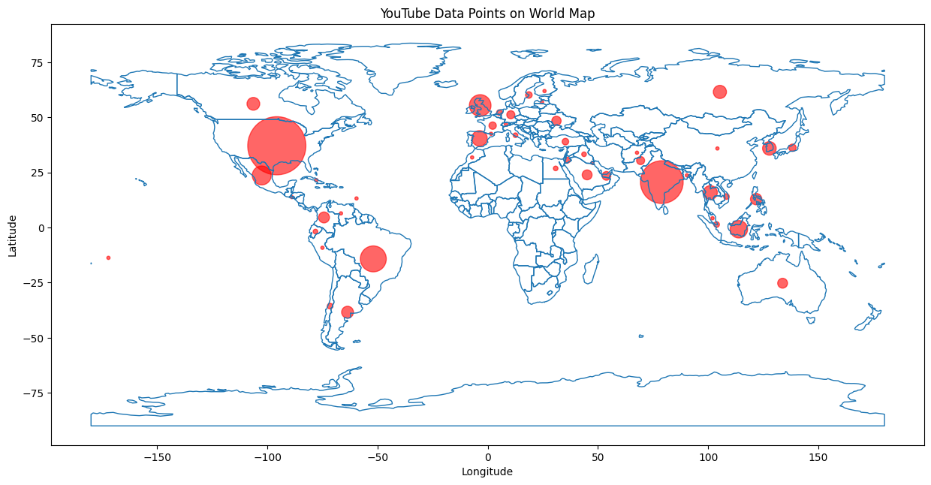
14. Are there any patterns in the distribution of YouTube channels based on latitude and longitude coordinates?

Slide 40
14. Are there any patterns in the distribution of YouTube channels based on latitude and longitude coordinates?
High Concentration Areas: North America, Europe, and India show a high number of YouTube channels.
Largest Circles: The United States and India have the largest circles, indicating the highest concentration of channels.
Lower Presence Regions: Africa, South America, and parts of Asia have smaller circles, suggesting fewer channels.
Internet Accessibility: Regions with better internet access and technology infrastructure have more channels.
Cultural Influence: The density of channels in areas like India suggests cultural factors play a role in content creation.
Economic Factors: Higher GDP per capita regions tend to have more content creators.

Slide 41
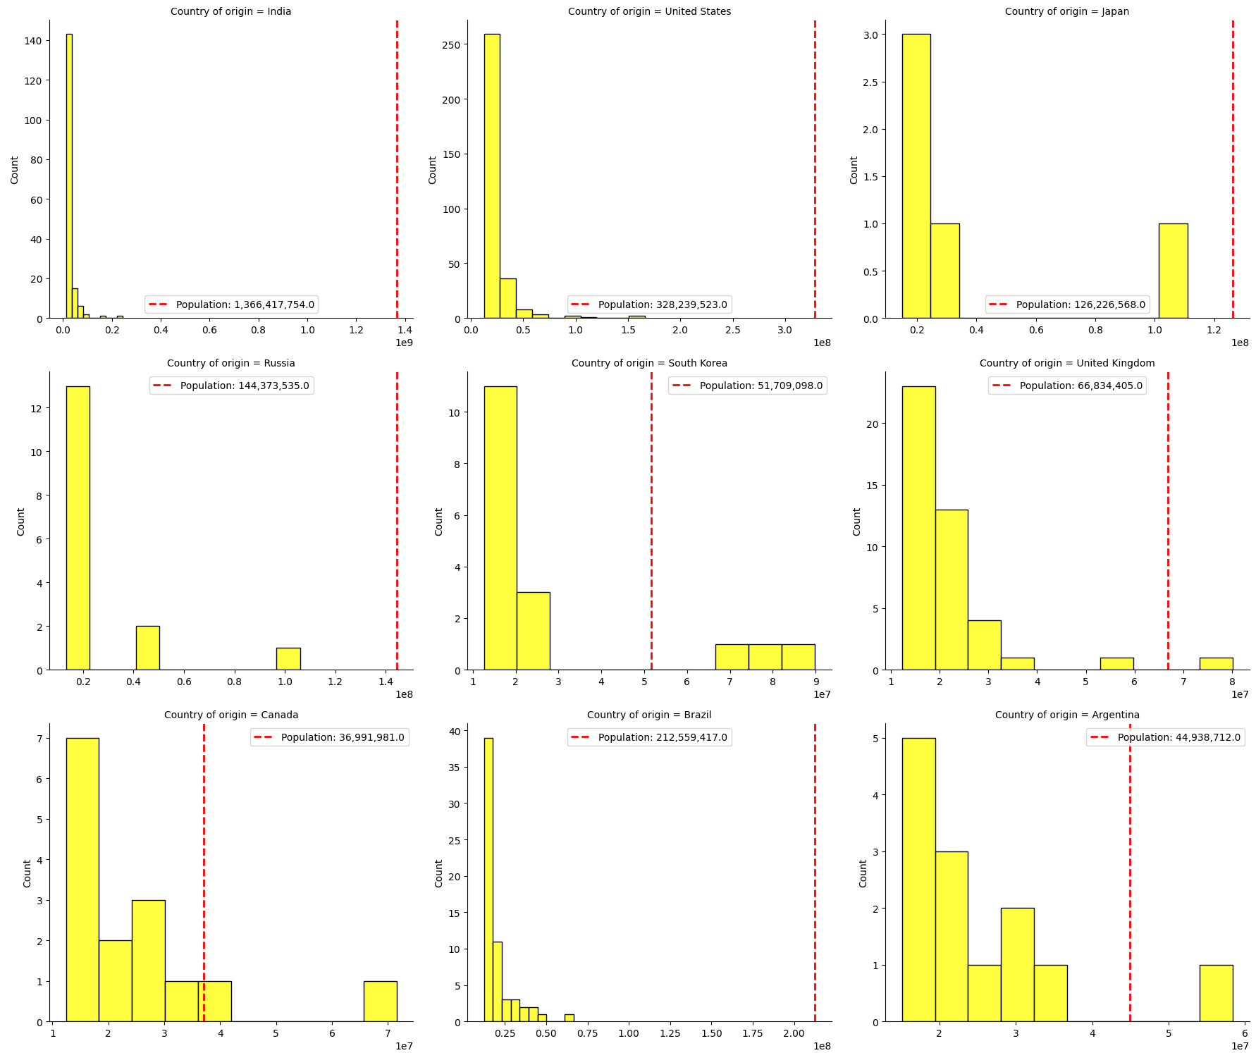
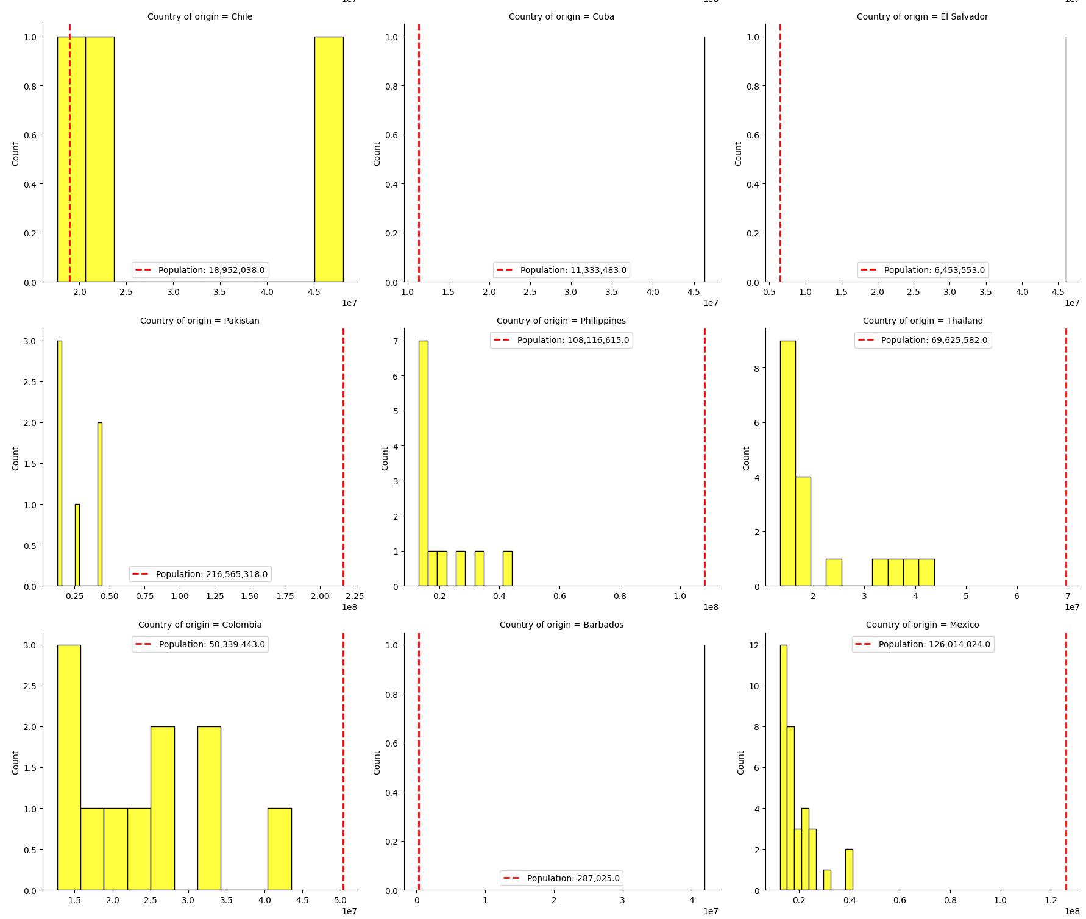
15. What is the correlation between the number of subscribers and the population of a country?

Slide 42
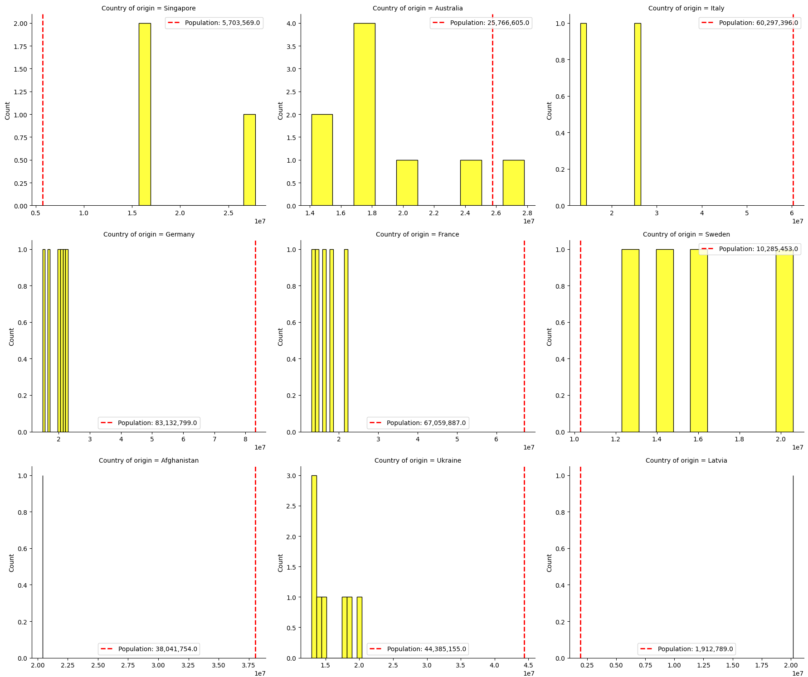
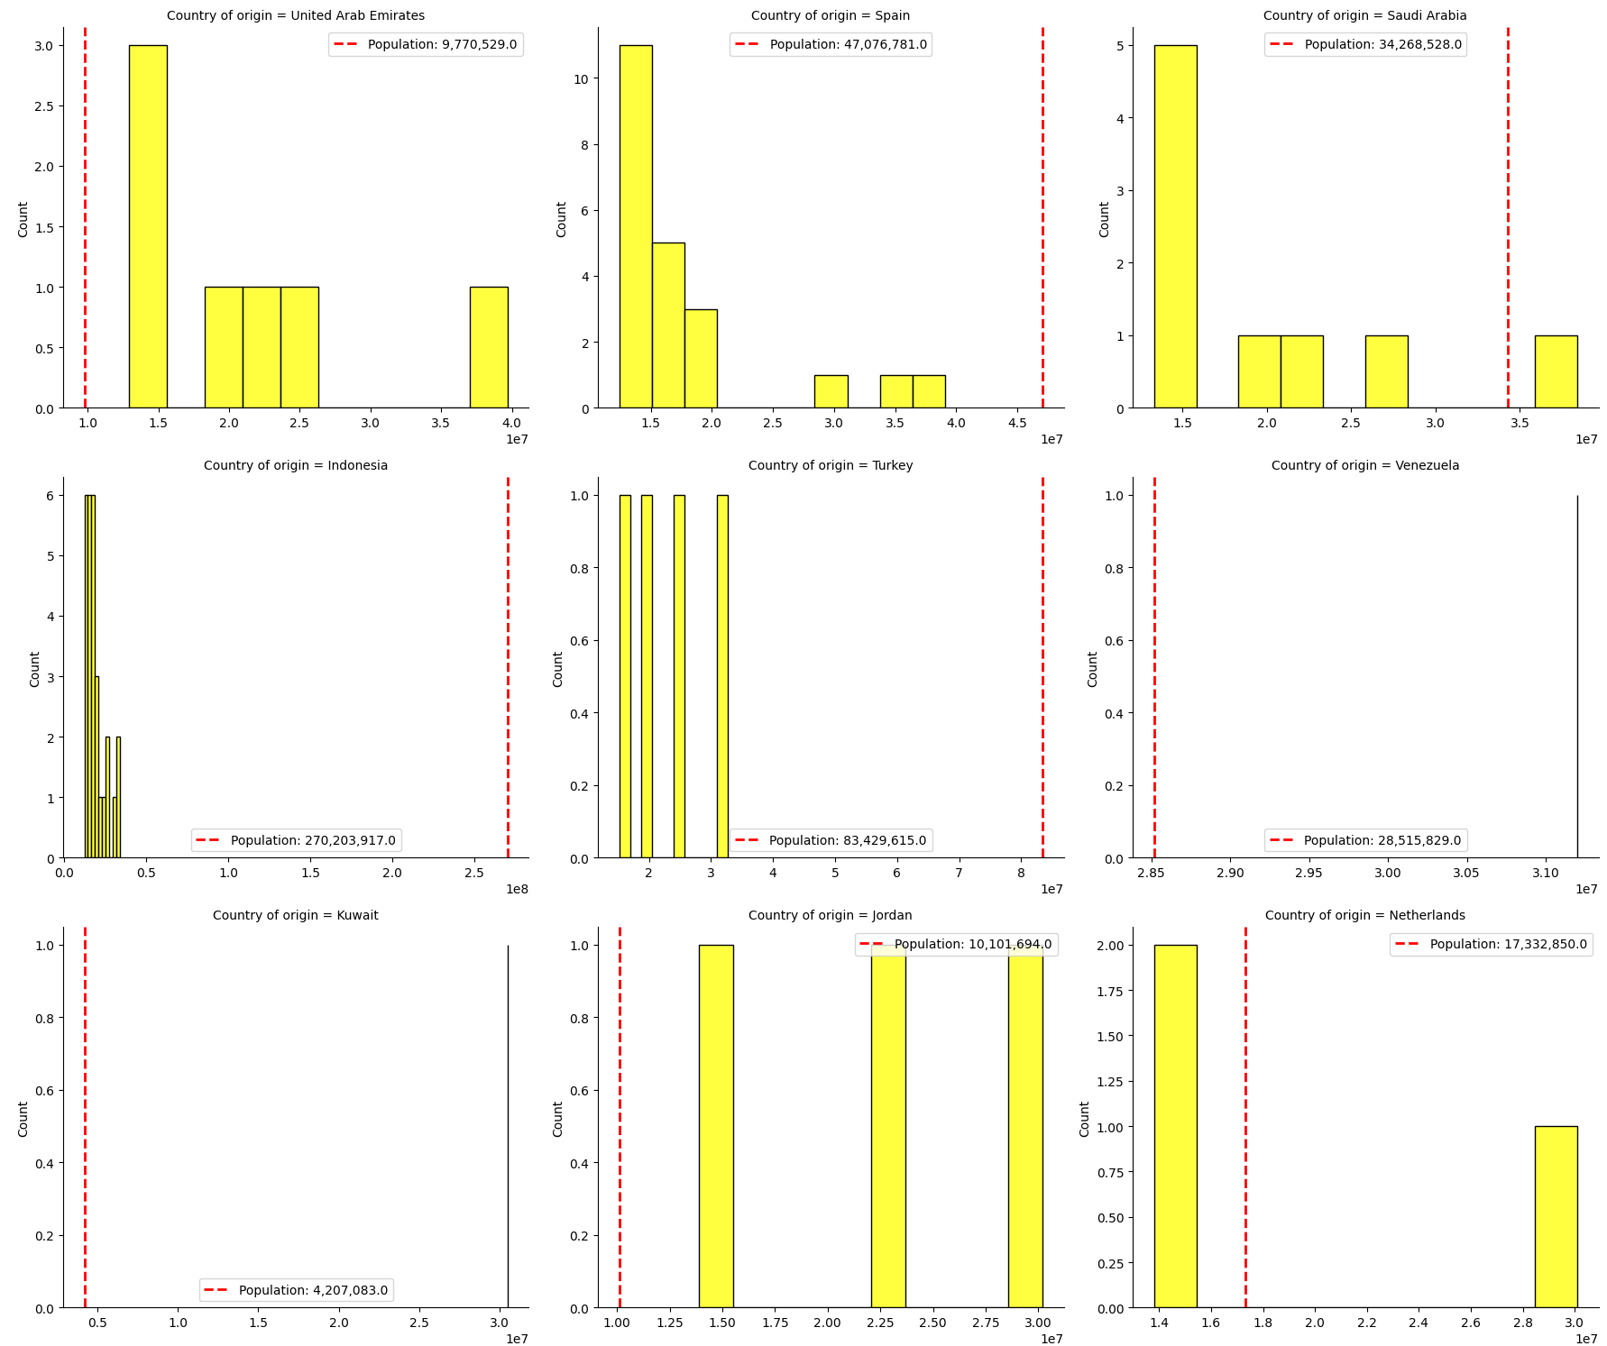
15. What is the correlation between the number of subscribers and the population of a country?

Slide 43
15. What is the correlation between the number of subscribers and the population of a country?
Subscriber Distribution: Most YouTube channels have a subscriber count that is significantly lower than the country’s population.
High Subscriber Rarity: Channels with a very high number of subscribers are rare, indicating a steep drop-off in frequency as subscriber numbers increase.
Similar Patterns: Despite cultural and regional differences, the subscriber distribution pattern is consistent across countries, with most channels falling into the lower subscriber count categories.
Growth Potential: There is a large potential for growth in subscriptions within these countries, as the majority of channels have fewer subscribers than the total population.
Quality or Marketing: The few channels with extremely high subscriber counts may indicate either superior content quality or more effective marketing strategies.
Common Viewer Behavior: The similarities in patterns suggest that viewer behavior and channel subscription dynamics are common across different national contexts.

Slide 44
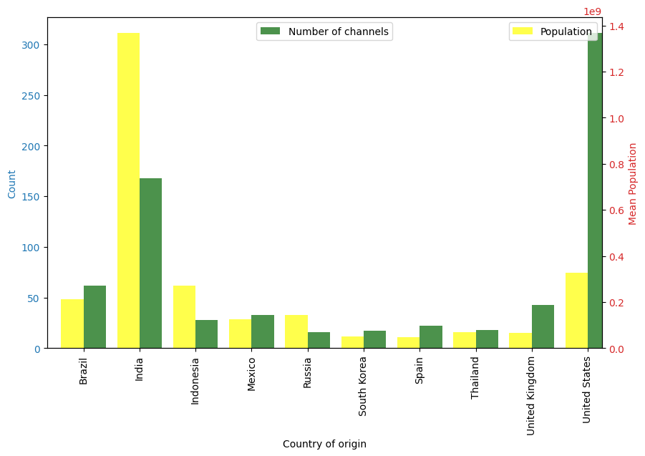
16. How do the top 10 countries with the highest number of YouTube channels compare in terms of their total population?

Slide 45
16. How do the top 10 countries with the highest number of YouTube channels compare in terms of their total population?
Population vs. Channels: There’s no direct correlation between a country’s population size and the number of YouTube channels.
Cultural and Internet Impact: Cultural factors and internet accessibility may influence the number of channels in countries with smaller populations.
Examples from the graph :
Brazil’s Dominance: Brazil has a significantly higher number of YouTube channels relative to its population (relative to other countries).
India’s Contrast: Despite India’s large population, the number of YouTube channels is comparatively low.
Balanced Ratios: South Korea and Thailand show a more balanced ratio between the number of channels and population.
Low Channel Count: Russia and Mexico have a lower number of YouTube channels compared to their populations.

Slide 46
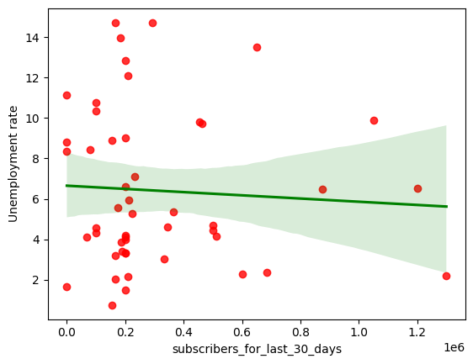
17. Is there a correlation between the number of subscribers gained in the last 30 days and the unemployment rate in a country?

Slide 47
17. Is there a correlation between the number of subscribers gained in the last 30 days and the unemployment rate in a country?
Weak Correlation: The flat regression line suggests a weak correlation between the number of new subscribers and the unemployment rate.
Data Spread: The red dots are scattered across the plot, indicating variability in the relationship.
Correlation vs. Causation: Even if a trend were observed, it would not necessarily imply that changes in subscriber numbers cause changes in unemployment rates without further investigation. There is no strong evidence of a direct relationship between recent subscriber gains and unemployment rates.

Slide 48
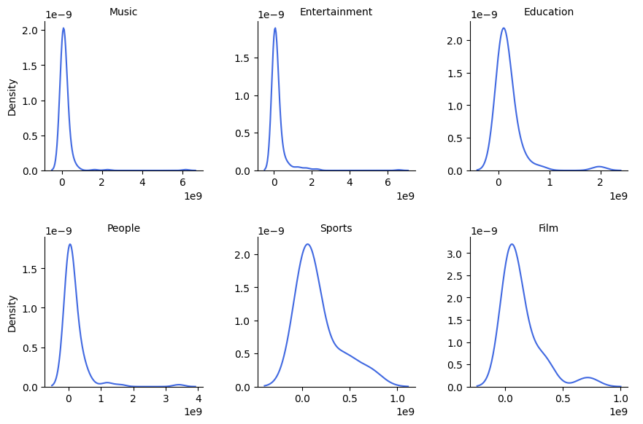
18. How does the distribution of video views for the last 30 days vary across different channel types?

Slide 49
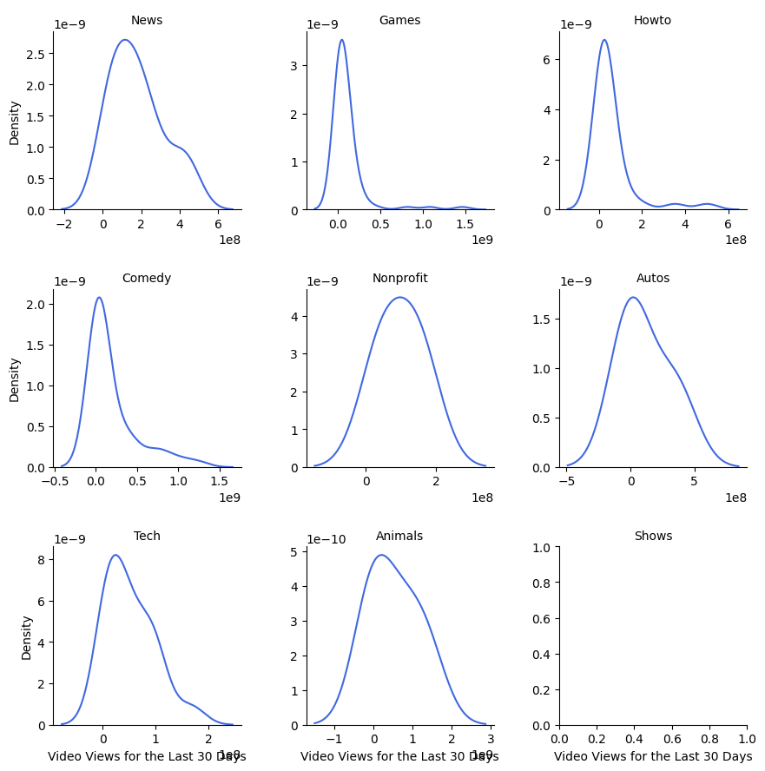
18. How does the distribution of video views for the last 30 days vary across different channel types?

Slide 50
18. How does the distribution of video views for the last 30 days vary across different channel types?
Right-Skewed Distributions: All channel types show right-skewed distributions, indicating most channels have lower view counts.
Music and Entertainment: These categories have a sharp peak at lower view counts, suggesting many channels don’t achieve high viewership.
Education and Film: These categories have a more spread-out distribution, hinting at a better chance for channels to gain higher views.
People Category: Shows greater variability in views, indicating a diverse range of channel success.
Sports Category: Exhibits a bimodal distribution, with peaks at low and high view counts, suggesting distinct groups within the category.

Slide 51
18. How does the distribution of video views for the last 30 days vary across different channel types?
News and Tech: These categories have a higher probability density for lower view counts, suggesting a concentration of channels with fewer views.
Games and Comedy: These categories show a broader spread of views, indicating a mix of channels with both low and high viewership.
Nonprofit and Autos: These graphs exhibit peaks at lower view counts, which may point to a niche audience or less frequent content uploads.
Broad Appeal: Categories like Games and Comedy have the potential to reach a wide audience due to the variability in viewership.
Niche Markets: Nonprofit and Autos channels might cater to specific interests, which could be leveraged for targeted marketing or community building.

Slide 52
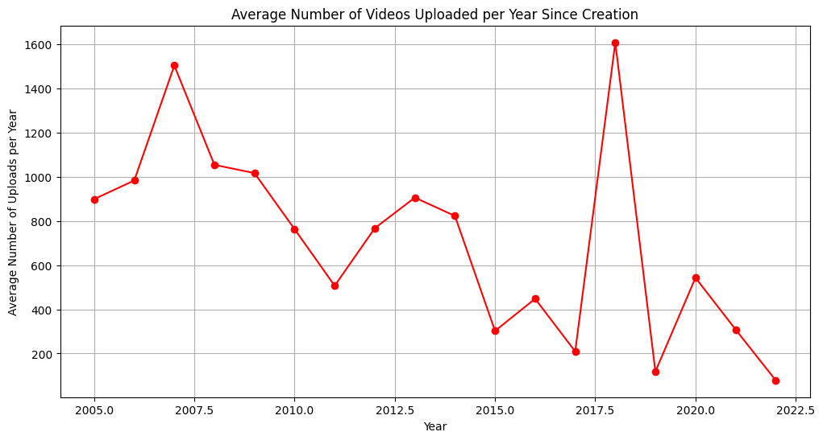
19. Are there any seasonal trends in the number of videos uploaded by YouTube channels?

Slide 53
19. Are there any seasonal trends in the number of videos uploaded by YouTube channels?
Early Growth: There was a surge in uploads around 2006, likely due to YouTube’s increasing popularity.
Subsequent Decline: A decline followed until 2008, possibly due to market saturation or changes in platform policy.
Stabilization: Between 2008 and 2015, upload patterns stabilized, suggesting creators found a consistent rhythm.
2018 Peak: A sharp peak occurred around 2018, indicating a change that encouraged more uploads, such as algorithm or policy shifts.
Platform Evolution: YouTube’s growth phases reflect its evolution and the changing landscape of online content creation.
Creator Adaptation: Content creators adapt their upload frequency in response to platform and market dynamics.

Slide 54
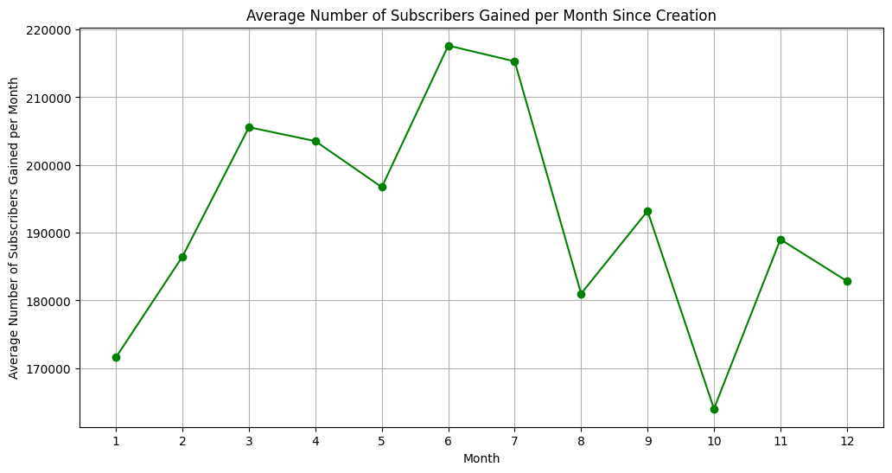
20. What is the average number of subscribers gained per month since the creation of YouTube channels till now?
Insights:
Mid-Year Peak: The highest average gain is around the seventh month, suggesting a seasonal or periodic trend in subscriber growth.
End-Year Decline: There’s a noticeable dip in the eleventh month, indicating a potential decrease in audience growth towards the year’s end.
Conclusions:
Strategic Timing: Content creators might consider timing their major releases or marketing efforts around mid-year to capitalize on higher subscriber growth rates.
Year-End Planning: The decline towards the end of the year could be used to plan for content strategies that maintain audience interest during this period.

Slide 55
PART – 4 : KEY TAKEAWAYS & CONCLUSION

Slide 56
Key Takeaways:
Content Strategy: Knowing which categories have the highest subscribers and video uploads can guide creators in choosing their niche.
Market Analysis: The top countries with YouTube channels can indicate market sizes and potential audience reach.
Engagement Metrics: Correlations between subscribers, views, and earnings can help in evaluating channel performance.
Economic Indicators: Relationships between YouTube channel metrics and tertiary education enrollment, unemployment rates, and urban population percentages may reflect broader socio-economic trends.
Geographical Patterns: Analysis of channel distribution by coordinates can reveal regional content preferences or accessibility issues.
Demographic Insights: Subscriber counts in relation to country populations can inform targeted marketing strategies.

Slide 57
Potential Uses:
Business Decisions: Brands can use these insights for targeted advertising and sponsorship opportunities.
Content Creators: Creators can optimize their content release schedules and topics for maximum impact.
Policy Making: Governments might use this data to understand digital literacy and economic opportunities in their regions.
Overall, this analysis could be instrumental in shaping digital media strategies across various stakeholders in the YouTube community.

Slide 58

THANK YOU
SPECIAL THANKS TO :

